Slide 1
Climate Data Services in support of Pacific activities
We have many different projects, each with similar “input” and “output” so the idea is to aggregate all this (and harmonize). Ideally, if someone wanted climate information, e.g., to inform a web site, they could follow a recipe that includes: 1) a climate index of interest, 2) the code used to make the index, and 3) the data accessed in the code

Slide 2
I. Main Components
Data Archive Catalog: A listing of data sources, ideally includes URL end points; this will be used as “input” to 2. [e.g., APDRC]
Code Repository: An open, web-based archive of scripts (jupyter notebooks) that are used to make plots, climate indices, etc. [GitHub]
Climate Indicators Catalog: Similar to (1), this would be a table/list of climate indicators; the list would include needed data (from 1), and the scripts used to produce it (from 2). [web matrix]
Projects: this might be specific to UH/NOAA; for us includes things like UNEP/GCF projects, DoS/ILR2030, Akamai Ag, but also things like NCRT’s, PCCM, etc.
1. Data Archive Catalog
2. Code Repository
3. Climate Indicators Catalog
4. Projects

Slide 3
1. Data Archive Catalog
Dimensions:
(G)lobal
(S)tation
Platform:
(S)atellite
(O)bs/in-situ
(M)odel
(R)enalysis
Timeframe:
(H)istorical
(R)ealtime
(F)orecast
(O)utlook
(P)rojection
(C)limatology
Time-res:
(H)ourly
(D)aily
(M)onthly
Ideally a list
that includes: Example 1 Example 2
Variable Sea level
Dataset AVISO Tide gauge
Dimensions (G)lobal (S)tation
Platform (S)atellite (O)bserved
Timeframe (H)istorical (H)istorical/(R)ealtime
Time-Res (W)eekly (H)ourly/(D)aily
Spatial-Res 1/2-degree N/A
Time-Range 1999-2009 Variable
Spatial-Range N/A N/A
Update cycle N/A (M)onthly
For example https://apdrc.soest.hawaii.edu

Slide 4
2. Code Repository
Here we are using GitHub
https://github.com/jpotemra/PCCM
https://jwfiedler.github.io/SL_Indicators/intro.html
https://github.com/pwoodworth-jefcoats/climate-indicators
https://github.com/teslakit/teslakit
https://github.com/nicolasfauchereau/ICU_Water_Watch/tree/main/notebooks
https://github.com/DaisyShi19/Palau-ocean-climate/tree/main

Slide 5
3. Climate Indicators Catalog
This would be a table/listing (searchable) that includes links to code and/or figures, e.g.,
http://lawelawe.pacioos.hawaii.edu/pacific-rcc/pccm_matrix/pccm_matrix.html

Slide 6
4. Projects
UNEP/GCF Ocean Portals (Palau, RMI)
UNEP/GCF CLEWS (Palau and RMI, Agro and Health)
DoS/ILR2030 ”blue dashboard” stuff
Akamai Ag
National Climate Report Templates
Pacific Climate Change Monitor
Meetings, etc. (PICOF, PICCF and such)

Slide 7
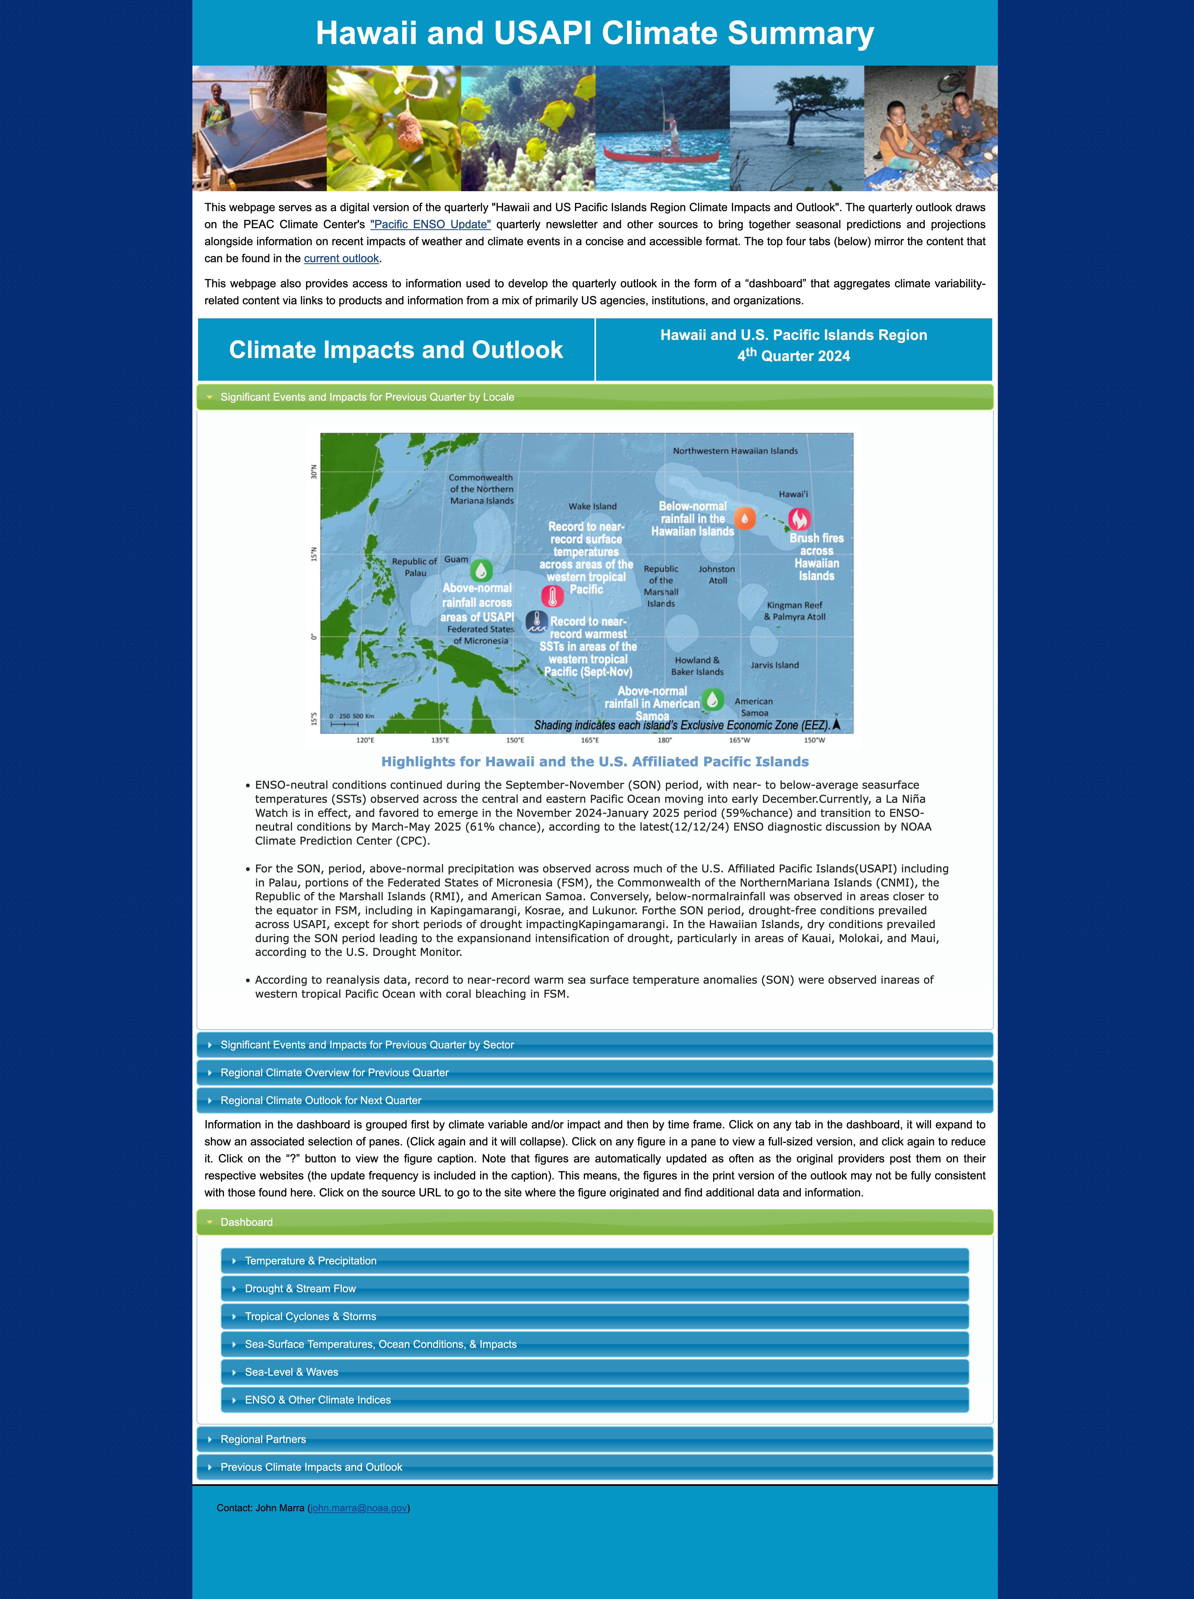
II. Past examples
PaCIS Climate Summary (aka quarterly report) https://apdrc.soest.hawaii.edu/Hawaii_USAPI_Climate_Summary/dashboard/

Slide 8
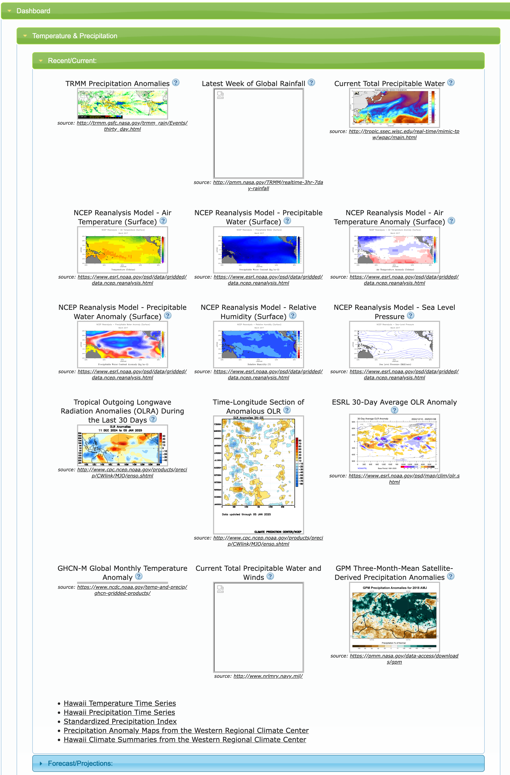
II. Past examples
PaCIS Climate Summary (aka quarterly report) https://apdrc.soest.hawaii.edu/Hawaii_USAPI_Climate_Summary/dashboard/

Slide 9
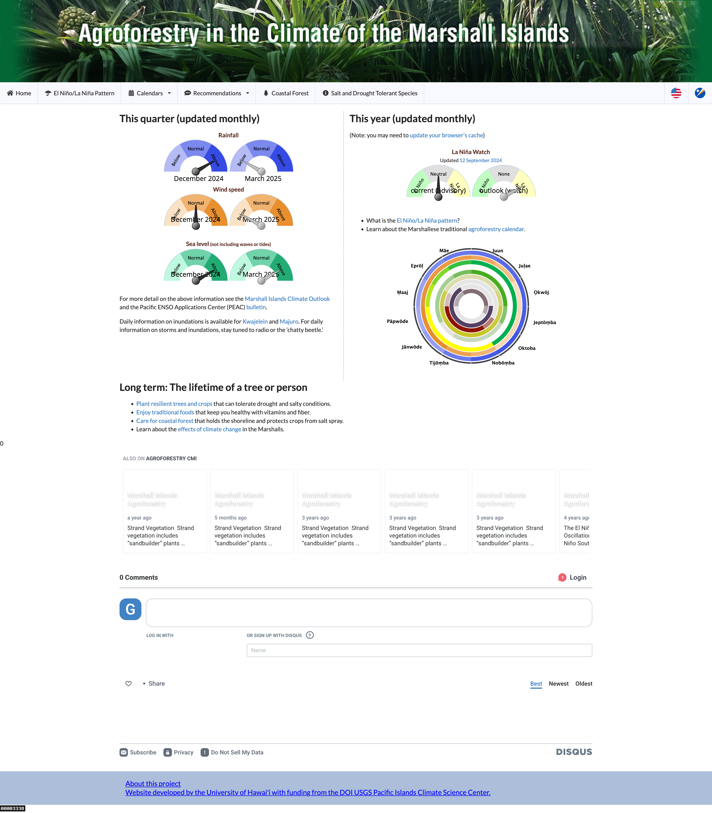
II. Past examples
Marshall Islands Agro-forestry
http://lawelawe.pacioos.hawaii.edu/pacific-rcc/Marshalls%20Agroforestry/site/index.php
Part 1: “Green site” with planting information, resources, guides, calendar, etc. Informed by “Blue site”

Slide 10
II. Past examples
Marshall Islands Agro-forestry
http://lawelawe.pacioos.hawaii.edu/pacific-rcc/Marshalls%20Agroforestry/site/index.php
Part 2: “Blue site” scanning data from CFSv2

Slide 11
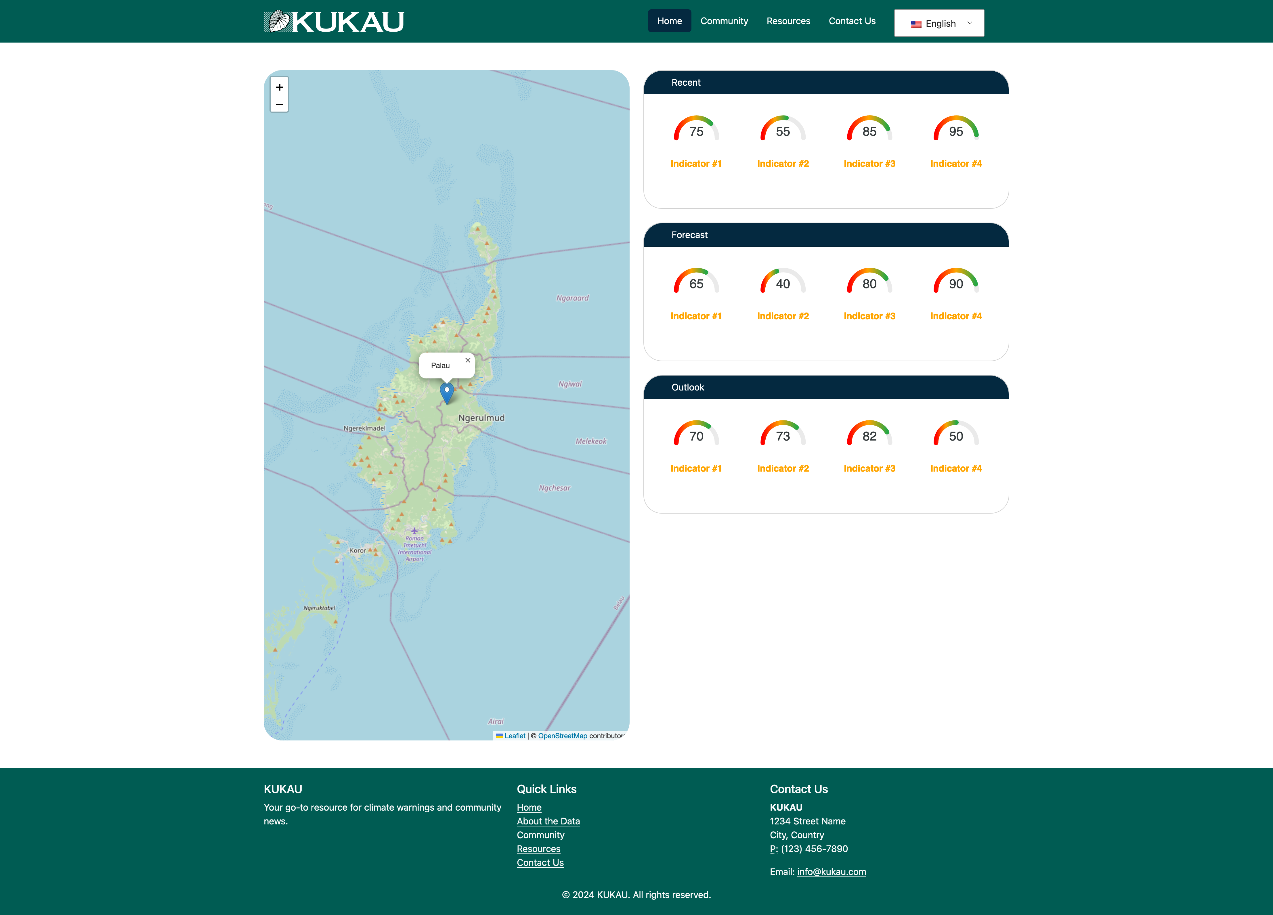
II. Past examples
Palau Kukau
https://www.kukau.org/

Slide 12
Variable | Recent | Forecast | Outlook
Rainfall | IRI, NWS | BoM | CFSv2
Wind speed | IRI, NWS | BoM | CFSv2
Air temp | IRI, NWS | BoM | CFSv2
Sea level | UHSLC | BoM | BoM
ENSO state | CPC | CPC

Slide 13
IRI
http://iridl.ldeo.columbia.edu/maproom/Global/Atm_Temp/index.html?bbox=bb%3A100%3A-60%3A300%3A60%3Abb
ERA-5 (Brentschneider)
http://data.61n150w.com/ERA5RankMaps.php
BoM
http://www.bom.gov.au/climate/pacific/outlooks/
Copernicus
https://climate.copernicus.eu/charts/packages/c3s_seasonal/
NCEI
https://www.ncei.noaa.gov/access/monitoring/usapi-pcp/all/PSW00040309
https://forecast.weather.gov/data/obhistory/PTRO.html

Slide 14
UHSLC
https://uhslc.soest.hawaii.edu/stations/?stn=007#levels
https://tidesandcurrents.noaa.gov/tide_predictions.html?gid=1848
ENSO
https://www.pacificmet.net/enso-tracker
https://www.cpc.ncep.noaa.gov/products/precip/CWlink/MJO/enso.shtml
http://www.bom.gov.au/climate/enso/?ninoIndex=nino3.4&index=nino34&period=weekly#tabs=Pacific-Ocean&pacific=Sea-surface
https://www.pacificmet.net/products-and-services/climate-bulletin
https://www.ncei.noaa.gov/access/monitoring/enso/soi

Slide 15
III. Partnerships/projects

